Slide 1
Comparison of Optical Transition, Diffraction, and Thermal Radiation
Matt Solt
2/5/2015
Stanford University

Slide 2
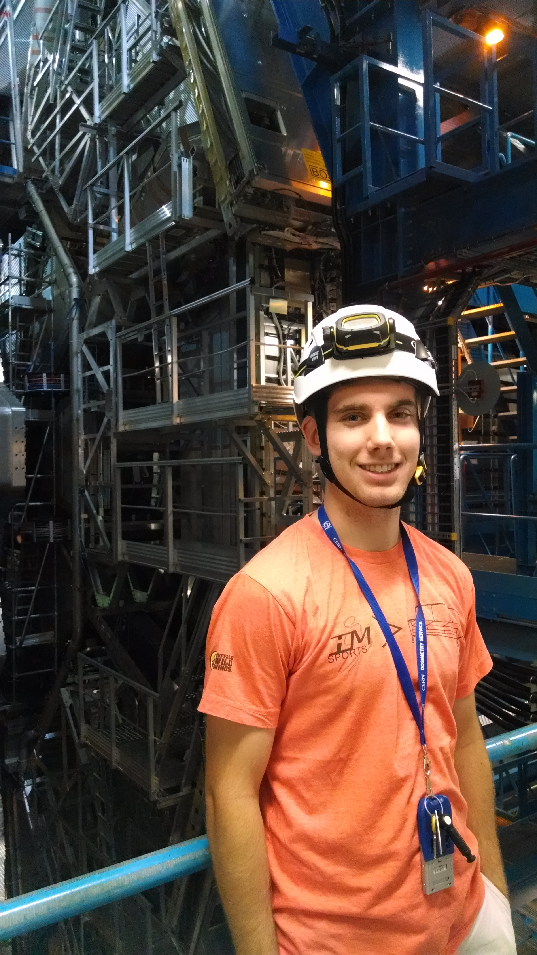
About Myself
Oakland University – Rochester, MI
B.S. Physics
B.S.E. Mechanical Engineering
Physics Graduate Student at Stanford
Previous Experience
Manufacturing Engineering Company – FATA Automation/Aluminum
REU at Michigan State (NSCL) in Nuclear Physics
REU at Cornell in Accelerator Physics
Theoretical Radiation Biophysics at Oakland
Tutoring and Teaching Physics, Math, and Engineering at Oakland
SLAC’s ATLAS group at CERN in HEP

Slide 3
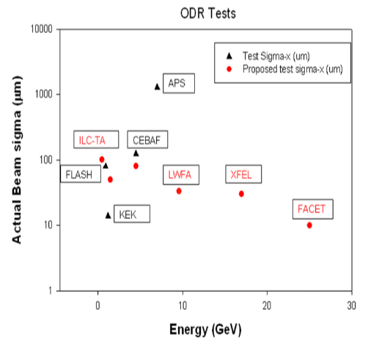
Goals and Motivation
See if Optical Diffraction Radiation is a legitimate beam diagnostic tool at FACET
Calculations and experiment
Motivation is a less invasive spot size measurement
Measurements performed at other laboratories
Compute the effects of Optical Thermal Radiation to see if it can interfere with OTR beam size measurements

Slide 4
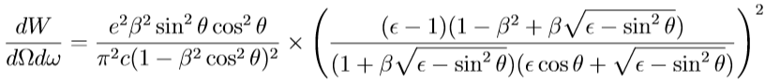
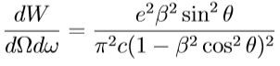
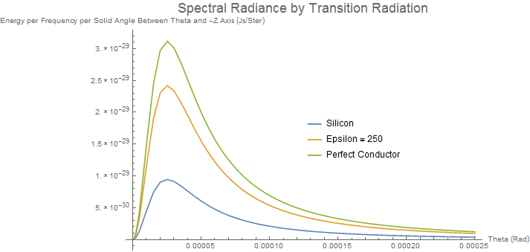
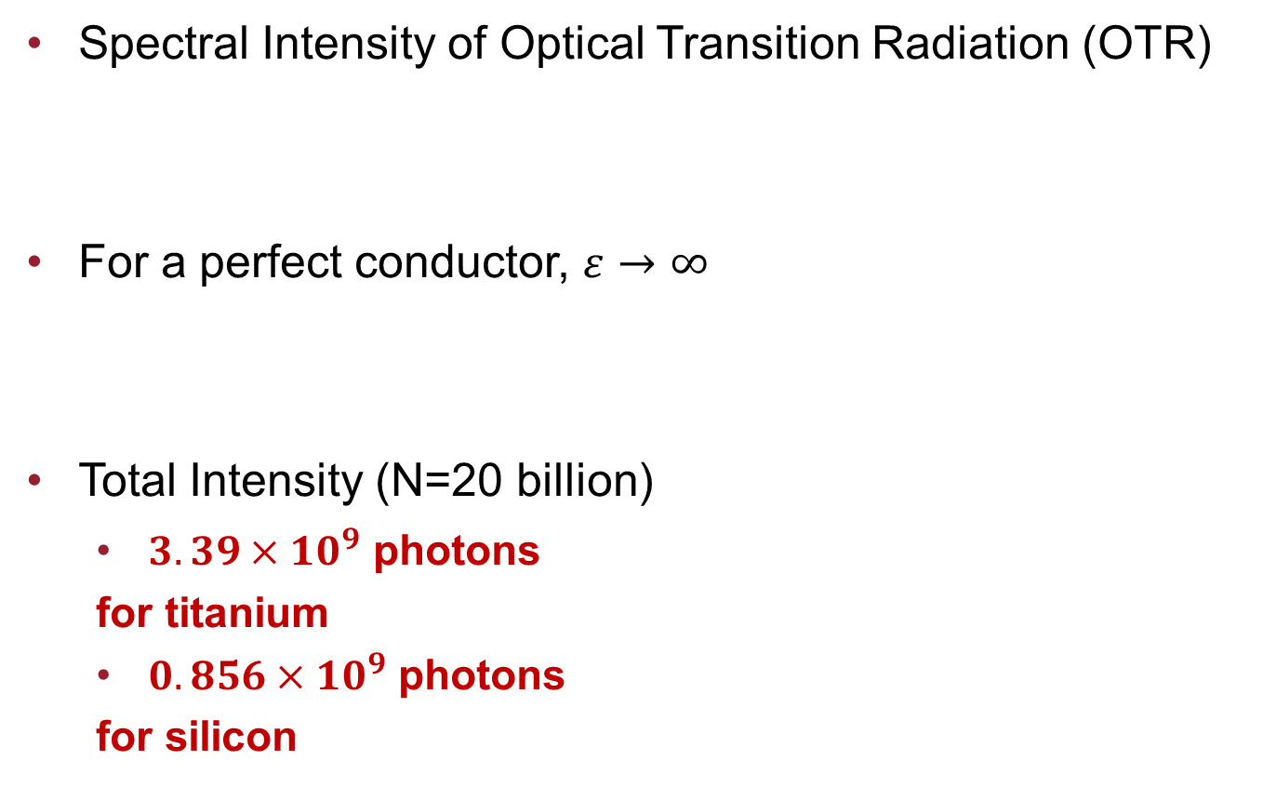
Optical Transition Radiation (OTR)
Spectral Intensity of Optical Transition Radiation (OTR)
For a perfect conductor, $ε→∞$
Total Intensity (N=20 billion)
$3.39×{10}^{9}$ photons
for titanium
$0.856×{10}^{9}$ photons
for silicon

Slide 5

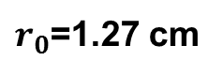
Optical Thermal Radiation – Statement of Problem
How does the radiation given off by OTR compare to the thermal radiation from the heated foil in the visible range?
Will this interfere significantly with measurements from cameras?
Analyze Steady State
Analyze “flash” immediately
after energy deposition
Assumptions
Neglect Radiation for
Steady State
Negligible Conduction for “flash”
Uniform Temperature
$r_{0}$=1.27 cm
$$σ=20μm$$

Slide 6
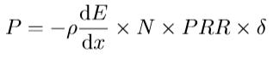
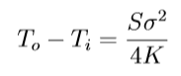
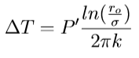
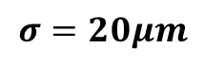
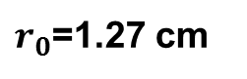
Optical Thermal Radiation (Steady State)
Total Power P delivered to a point on a screen of thickness δ = 25 μm for a beam with 10 billion electrons, N, and a pulse repetition rate, PRR, of 10 Hz is < 1 mW
Temperature difference between foil and surroundings is < 0.1 K
Temperature difference between foil
and beam spot is < 1 K
$r_{0}$=1.27 cm
$$σ=20μm$$

Slide 7
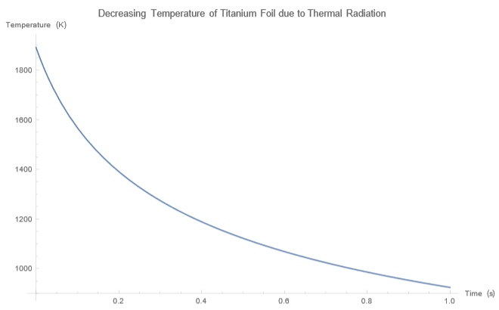
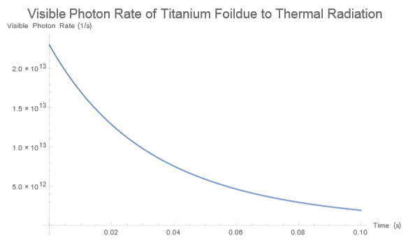
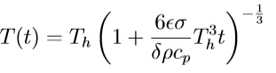
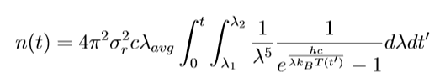
Optical Thermal Radiation
How much light from a “flash?”
Neglect radiation on foil due to surroundings
Ignore conduction and start at a temperature just below melting
Takes a “long time” to cool down

Slide 8
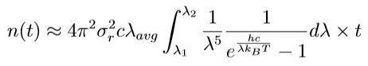
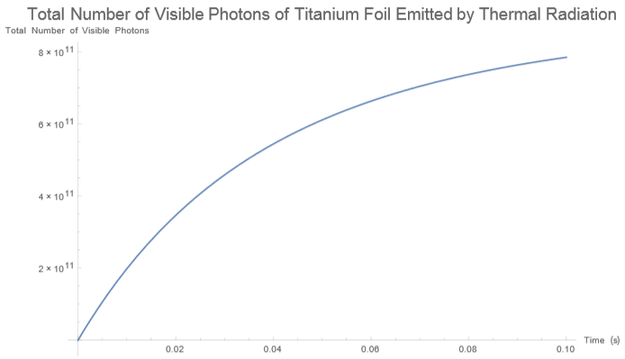
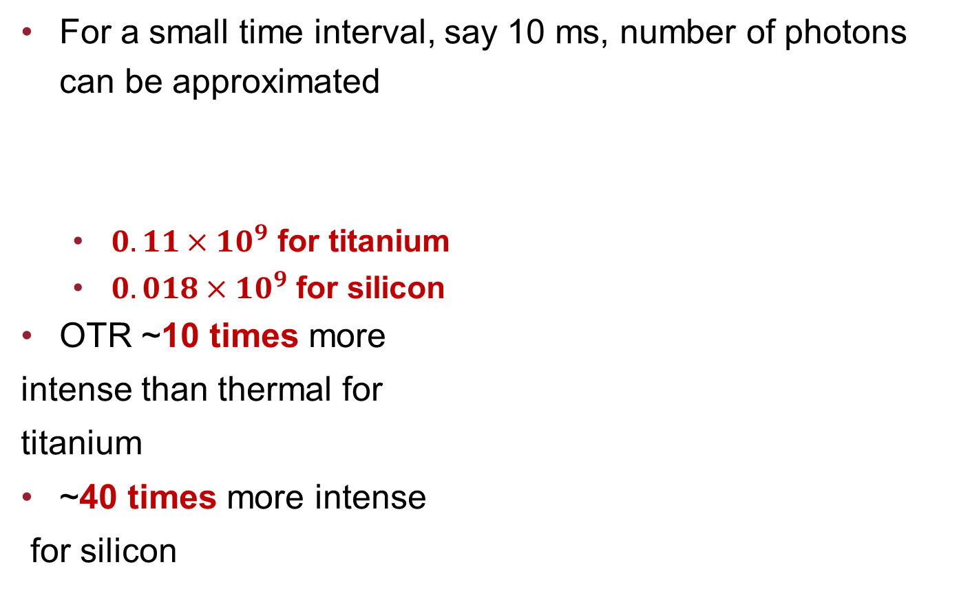
Optical Thermal Radiation
For a small time interval, say 10 ms, number of photons can be approximated
$0.11×{10}^{9}$ for titanium
$0.018×{10}^{9}$ for silicon
OTR ~10 times more
intense than thermal for
titanium
~40 times more intense
for silicon

Slide 9
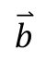
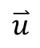
Optical Diffraction Radiation (ODR)
The optical diffraction radiation (ODR) due to an incident beam passing near a flat edge
a is the impact parameter – shortest distance from the foil to the center of the beam
$$\overset{⃑}{u}$$
y
a
$$\overset{⃑}{b}$$
x

Slide 10
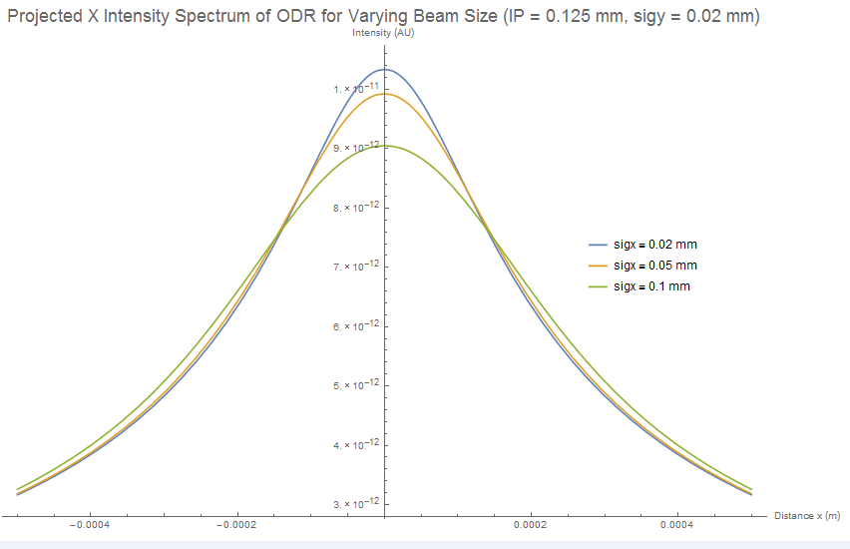
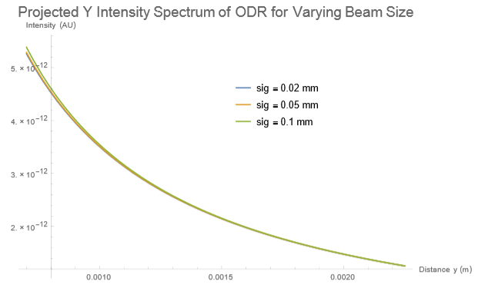
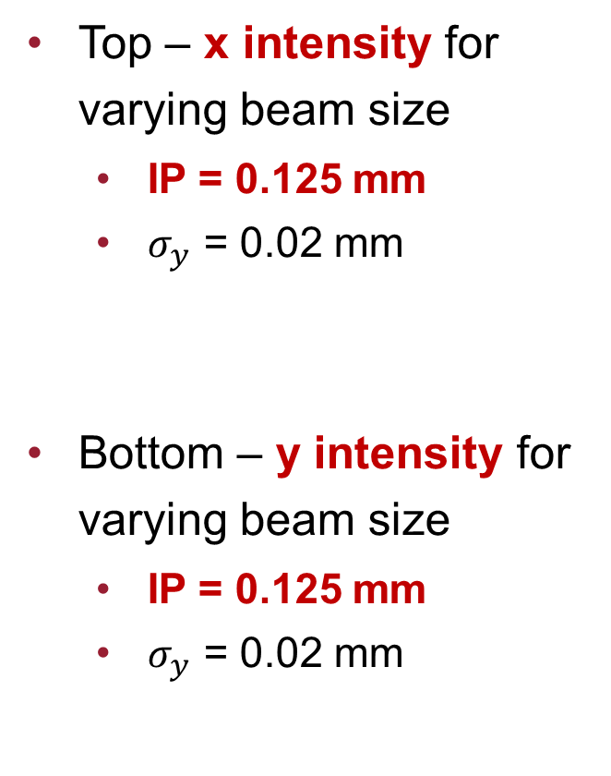
Optical Diffraction Radiation
Top – x intensity for varying beam size
IP = 0.125 mm
$σ_{y}$ = 0.02 mm
Bottom – y intensity for varying beam size
IP = 0.125 mm
$σ_{y}$ = 0.02 mm

Slide 11
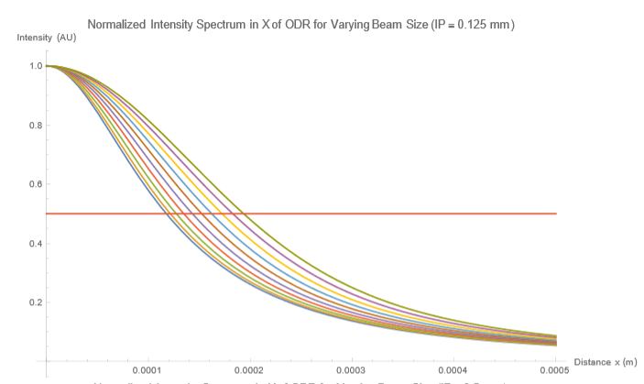
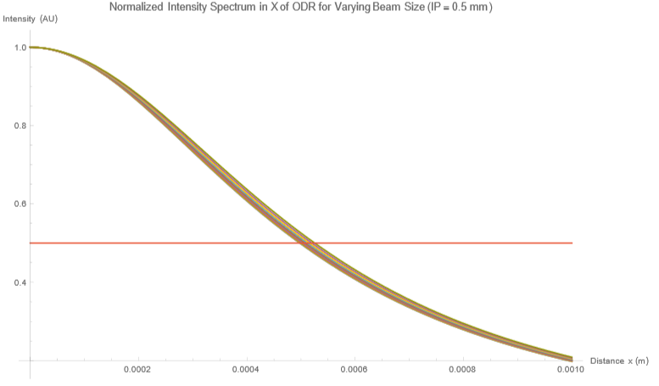
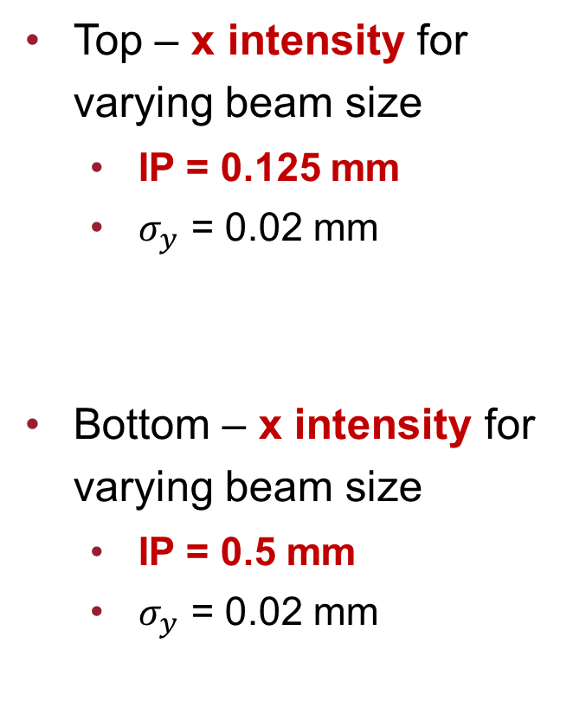
Optical Diffraction Radiation
Top – x intensity for varying beam size
IP = 0.125 mm
$σ_{y}$ = 0.02 mm
Bottom – x intensity for varying beam size
IP = 0.5 mm
$σ_{y}$ = 0.02 mm

Slide 12
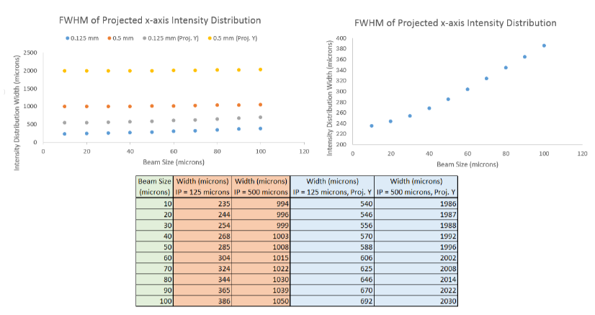
Optical Diffraction Radiation

Slide 13
Calculation Conclusions
OTR calculations for silicon and titanium complete.
Silicon is about ¼ the intensity of titanium
Optical thermal radiation is not a major factor in steady state
At worst cast scenario, OTR dominates optical thermal radiation in both silicon and titanium
ODR should be successful in measuring large beam size
ODR may not be successful for measuring smaller beam size
Calculation of ODR’s polarization components may be necessary

Slide 14
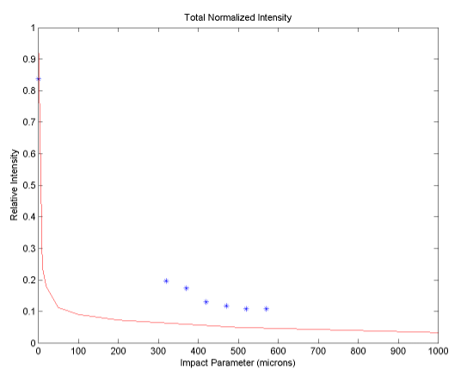
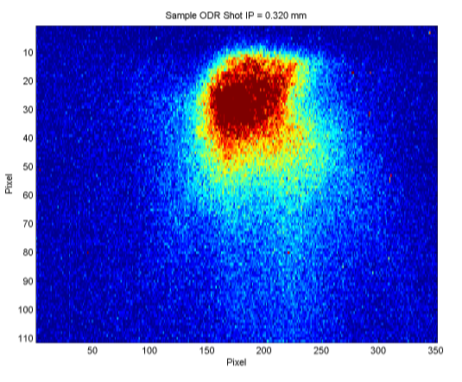
Optical Diffraction Radiation Measurements
Data was taken during on a day with a poor beam quality with limited time. Most analysis was impractical.
Did we see ODR, or did we see beam tail OTR?
My job to convince you we saw ODR

Slide 15
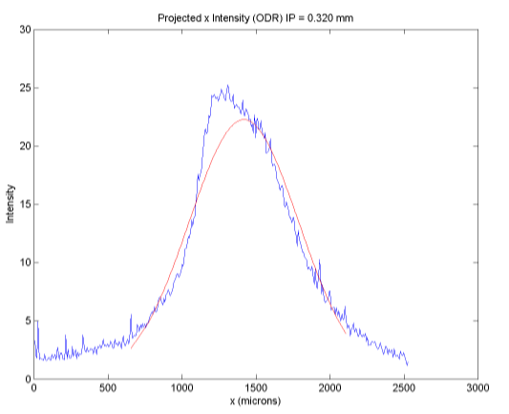
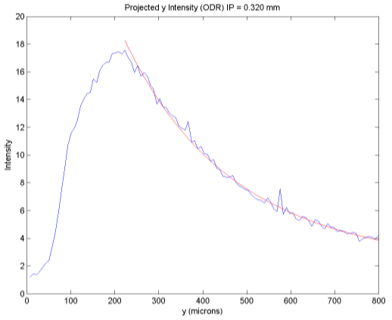
Measured X and Y Intensity Spectrums
X Spectrum should be approximately Gaussian
Y Spectrum should have a Gaussian tail
Why does the leading edge not have a sharp slope?

Slide 16
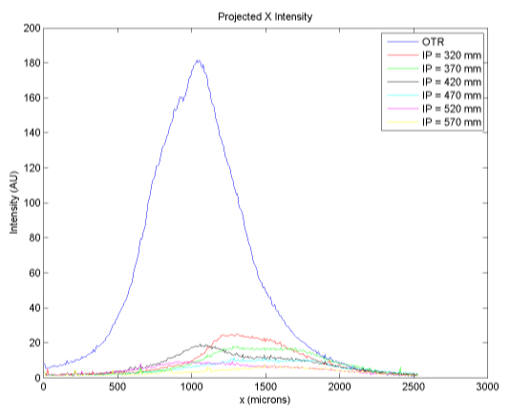
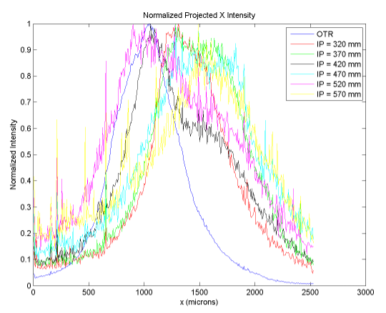
Measured X Intensity Spectrum
X intensity spectrum decreases with impact parameter
Width of X intensity increases slightly with impact parameter

Slide 17
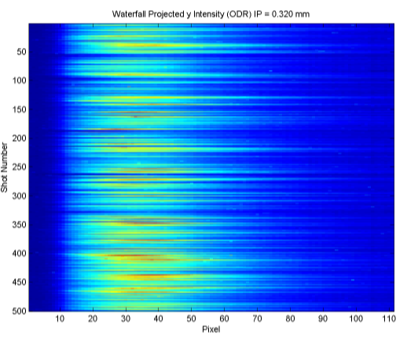
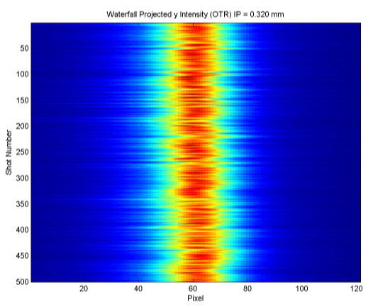
Waterfall Plot of Y Intensity
Left is ODR. Right is OTR.
Waterfall Plots of Y Intensity

Slide 18
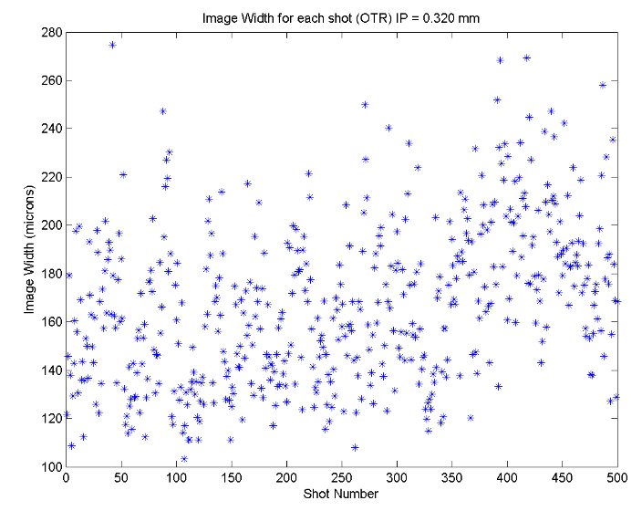
Measurement Conclusion and Future Work
ODR was observed experimentally at FACET
Analysis was not much use with poor beam quality
In the future, take data with a good quality beam
Vary beam size and more range in varying impact parameter

Slide 19
Conclusions and Future Plans at Stanford
Learned much about FACET and still have much to learn
Also developed many useful skills including data taking, calculations, and surviving tunnel work
Contributed to many aspects including thermal radiation issues and OTR/ODR measurements/calculations
Taking full advantage of
Stanford’s rotation system
Joined LUX/LZ Dark
Matter search
One more Spring quarter
rotation

Slide 20
References
http://inspirehep.net/record/562218/files/slac-r-576.pdf
Accelerator Handbook
http://slac.stanford.edu/pubs/slacpubs/15500/slac-pub-15729.pdf
http://journals.aps.org/prstab/pdf/10.1103/PhysRevSTAB.10.022802
http://arxiv.org/ftp/arxiv/papers/1208/1208.4344.pdf

Slide 21
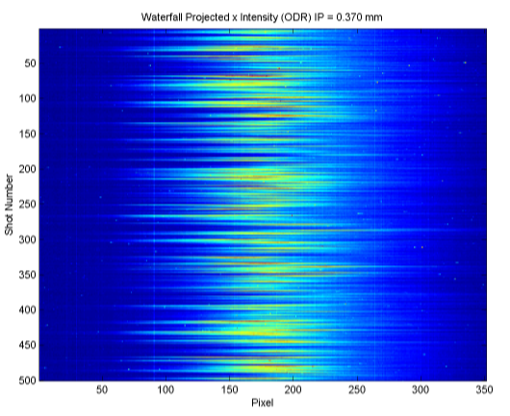
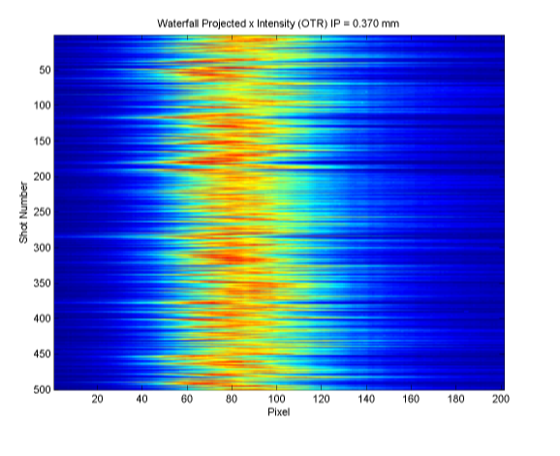
Supplemental Slide 1

Slide 22
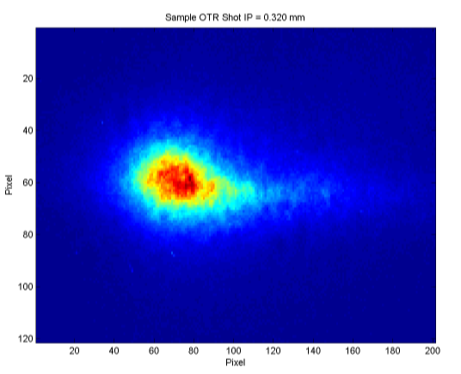
Supplemental Slide 2

Slide 23
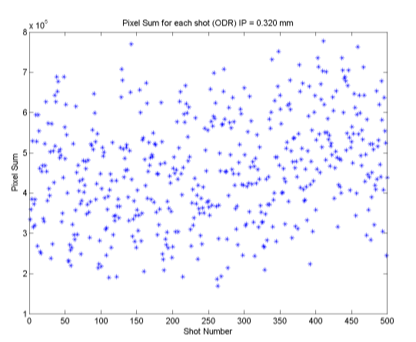
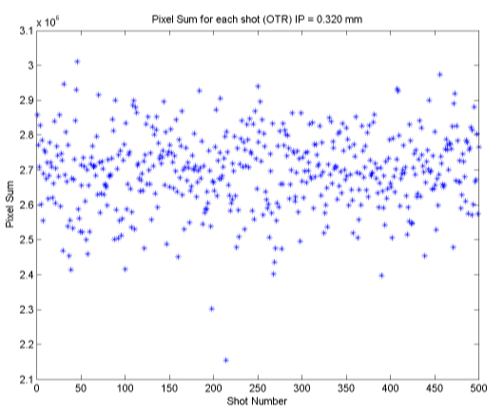
Supplemental Slide 3

Slide 24
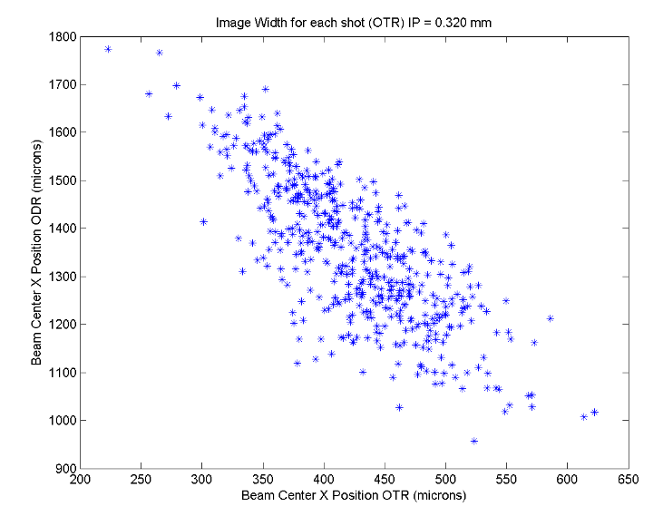
Supplemental Slide 4

Slide 25
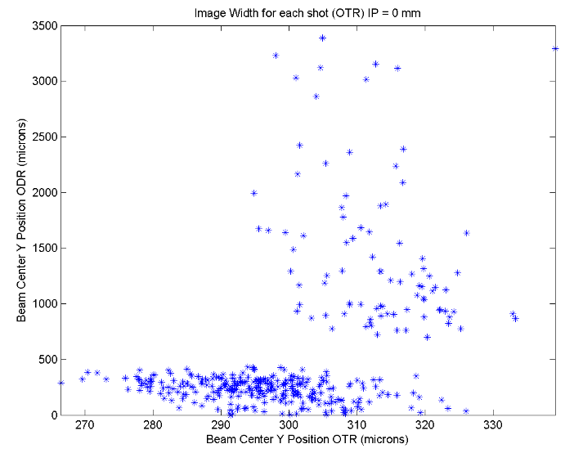
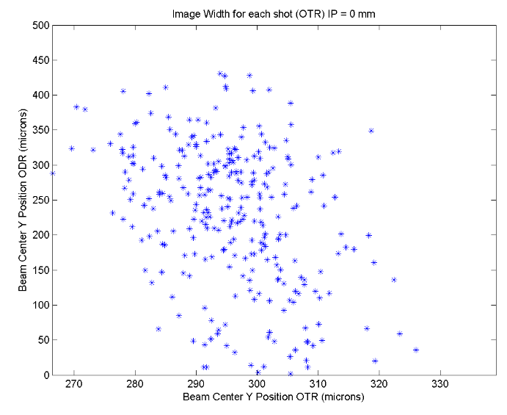
Supplemental Slide 5

